Slide 1
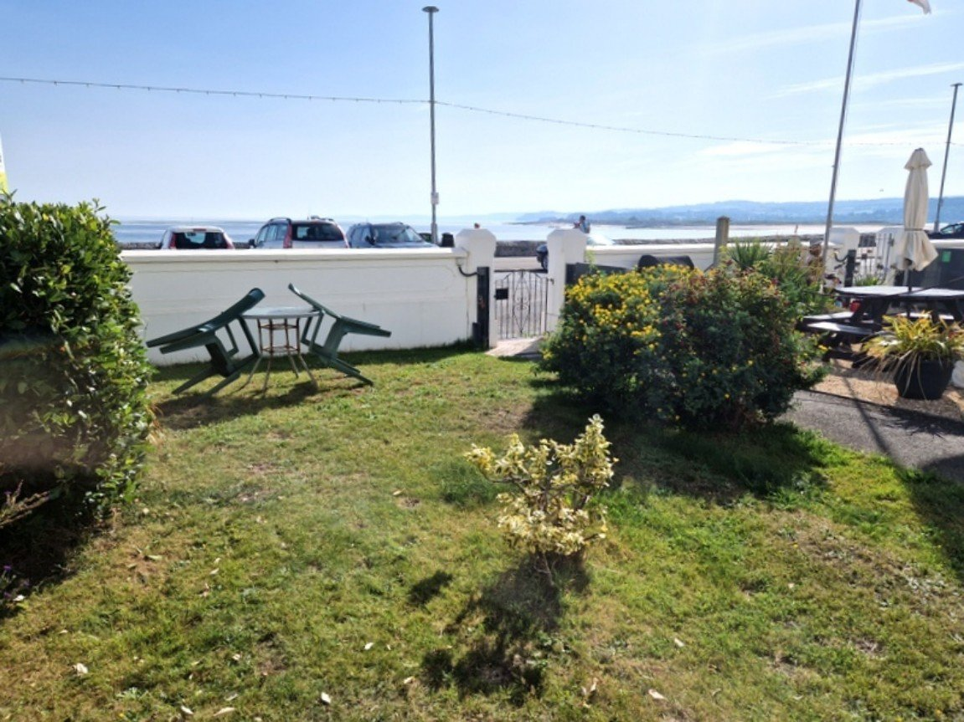
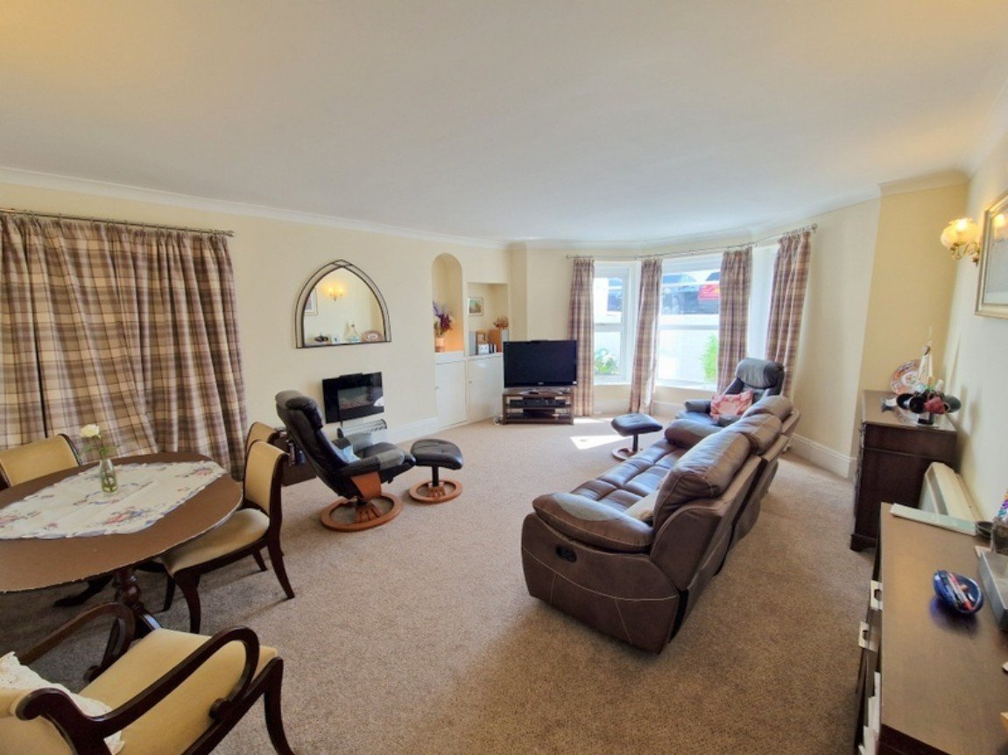
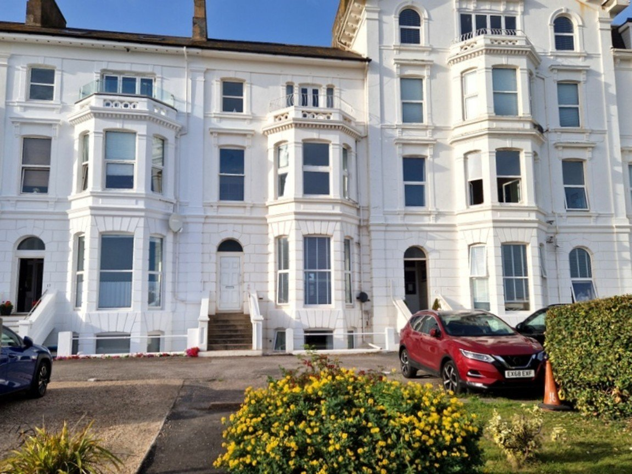
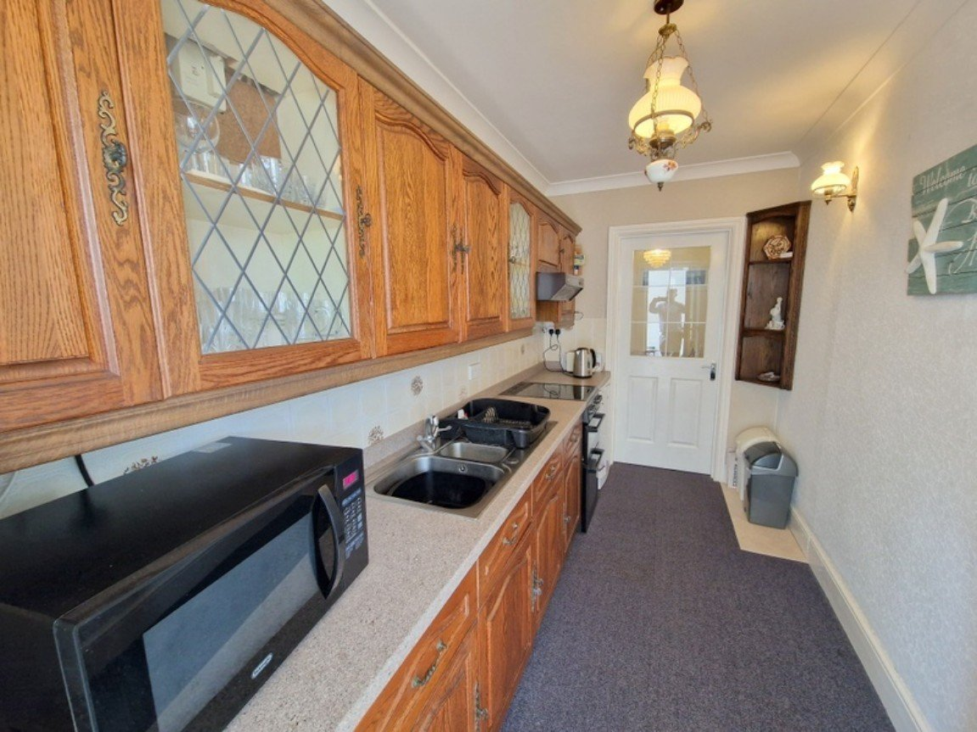
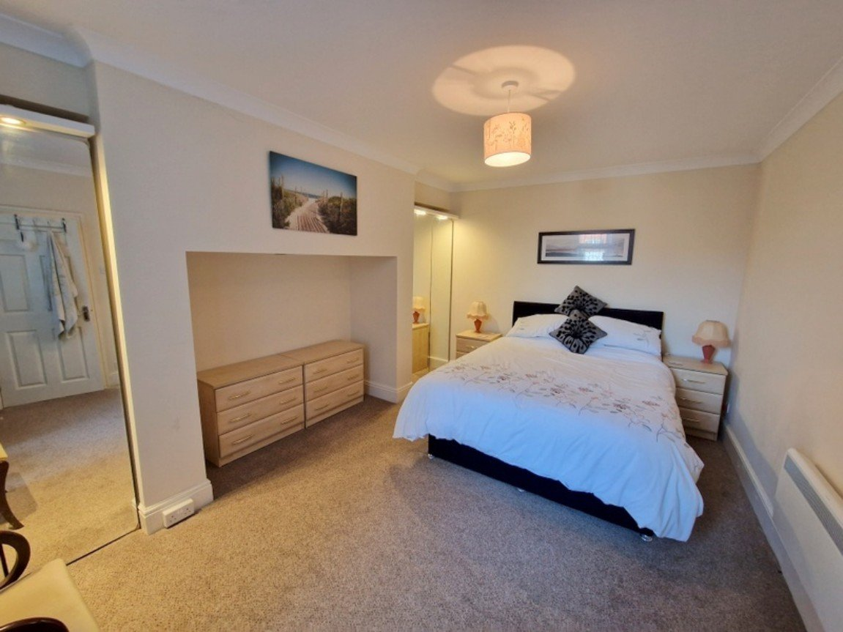
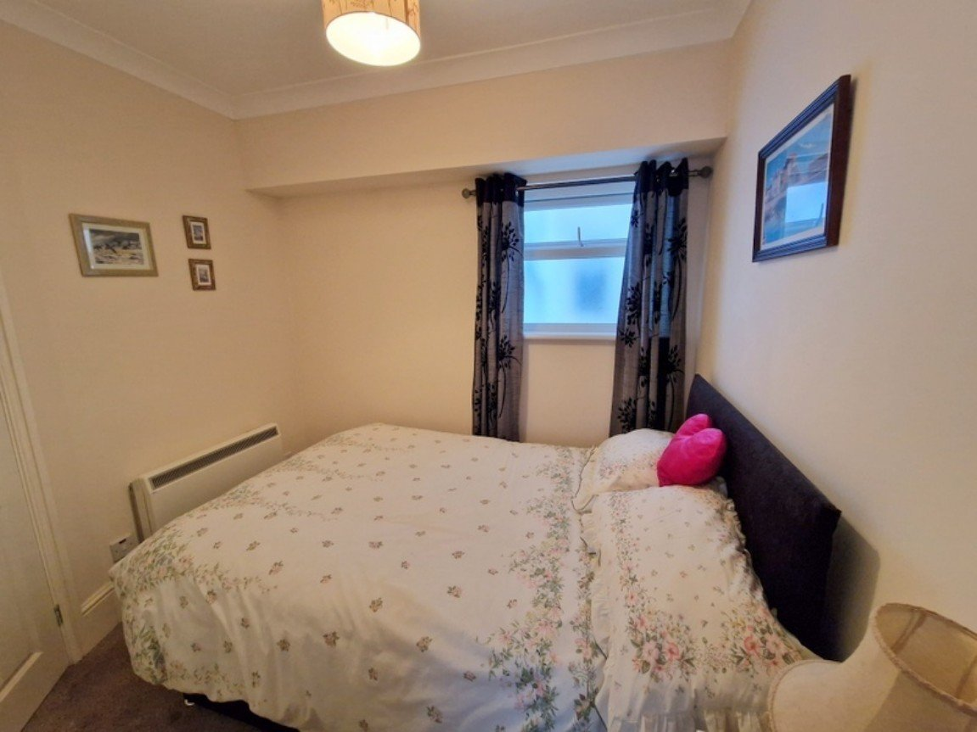
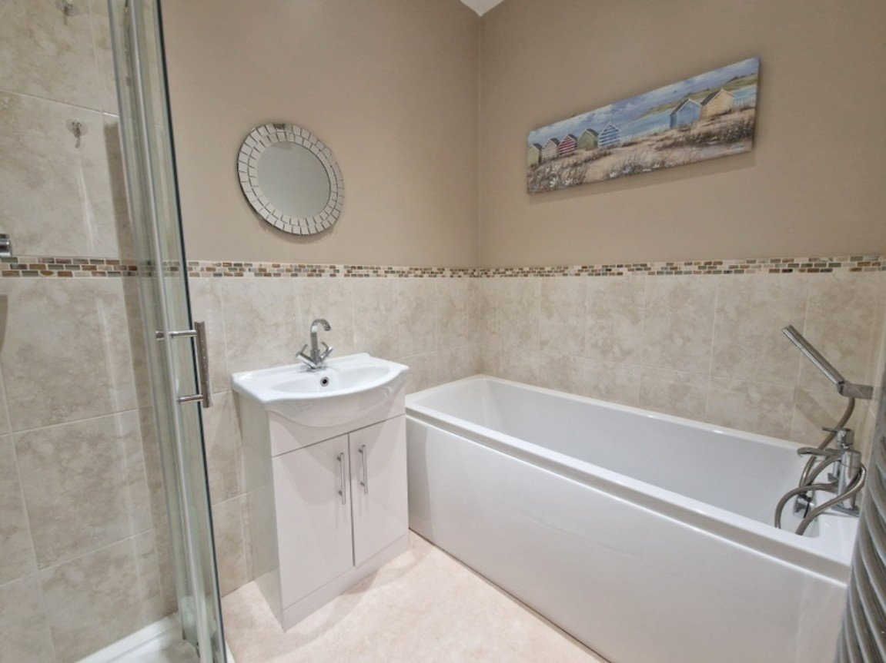
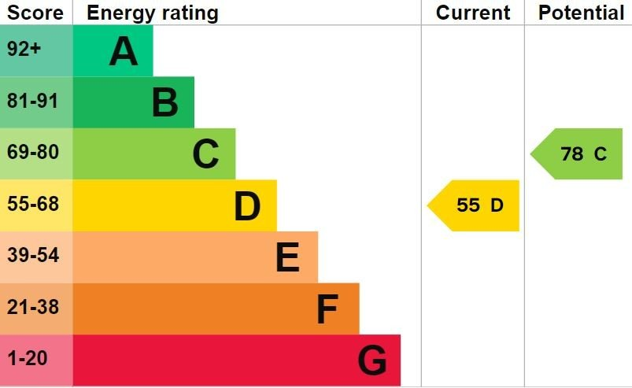
www.pennys.net
Flat 1a, 16 Morton Crescent, Exmouth, EX8 1BG
GUIDE PRICE £300,000
TENURE Share of Freehold
A Well Presented And Refurbished Two Bedroom Apartment With Its Own Garden Overlooking The Seafront And Parking Area
Own Entrance • Kitchen • Breakfast Area • Spacious Lounge/Dining Room •
Two Bedrooms • Modern Bathroom With Bath & Shower Cubicle • Separate W/C •
Own Front Garden And Rear Courtyard •
No Onward Chain •
Pennys Estate Agents Limited for themselves and for the vendor of this property whose agents they are give notice that:- (1) These particulars do not constitute any part of an offer or a contract. (2) All statements contained in these particulars are made without responsibility on the part of Pennys Estate Agents Limited. (3) None of the statements contained in these particulars are to be relied upon as a statement or representation of fact. (4) Any intending purchaser must satisfy himself/herself by inspection or otherwise as to the correctness of each of the statements contained in these particulars. (5) The vendor does not make or give and neither do Pennys Estate Agents Limited nor any person in their employment has any authority to make or give any representation or warranty whatever in relation to this property.
PENNYS ESTATE AGENTS
2 Rolle House, Rolle Street, Exmouth, Devon, EX8 2SN
Tel: 01395 264111 EMail: help@pennys.net

Slide 2
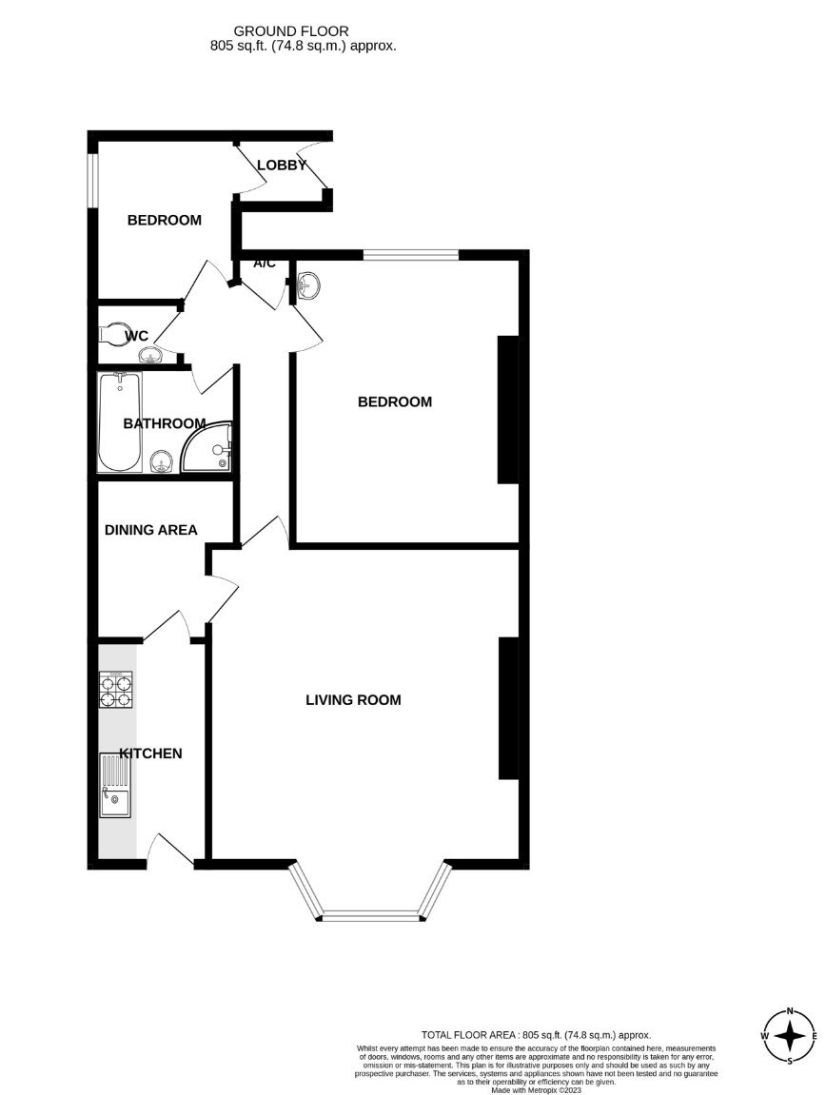
Flat 1a, 16 Morton Crescent, Exmouth, EX8 1BG
THE ACCOMMODATION COMPRISES: uPVC front door giving access to: KITCHEN: 3.35m x 1.83m (11'0" x 6'0") Fitted with pattern work top surfaces with matching splash back; inset one and a quarter bowl sink unit with cupboards, drawer units and appliance space beneath; wall mounted cupboards; electric cooker point; cupboard housing electric meter; extractor fan. BREAKFAST ROOM: 2.59m x 2.13m (8'6" x 7'0") narrowing to 6ft (1.83m) Electric wall heater; electric consumer unit; door to: LOUNGE/DINING ROOM: 6.38m x 4.72m (20'11" x 15'6") Into double glazed bay window to front elevation; fitted cupboards in wall recess; "pull down bed housed in wall recess"; wall mounted electric fire; television point; wall lighting. INNER HALLWAY: Wall mounted electric heater; airing cupboard with water cylinder; recess LED lighting. BEDROOM ONE: 4.7m x 3.68m (15'5" x 12'1") Into wall recess. Two double glazed windows to rear elevation; wall recesses both housing mirror fronted wardrobes with display lighting; wall mounted electric heater; vanity wash hand basin with tiled splash back and light/shaver socket over. BEDROOM TWO: 2.67m x 2.31m (8'9" x 7'7") Double glazed window with frosted glass; electric heater; door to: REAR LOBBY: 1.52m x 1.22m (5'0" x 4'0") With uPVC double glazed door to rear courtyard garden; fitted cupboard. BATHROOM/WC: 2.34m x 1.6m (7'8" x 5'3") Stylishly fitted with modern suite comprising of a bath with shower attachment; shower cubicle, shower unit and splash screen with curved doors; vanity wash hand basin; tiling to splash prone areas; chrome heated towel rail; recess ceiling LED lighting. SEPARATE W/C: Space saver W/C with push button flush; wash hand basin; recess ceiling LED lighting. OUTSIDE: To the front of the property the property enjoys the use of a parking area. The apartment also owns a garden overlooking the seafront which is laid to lawn with shrubs providing an ideal place for outside entertaining with direct views to the sea. The property also benefits from its own rear courtyard garden with an outside tap and pedestrian gate providing rear access. TENURE AND OUTGOINGS: The property is held on a 999 year lease with the benefit of owning a 1/5th share of the freehold. Service charge is based on a 1/8th share of outgoings on an as and when basis.
FLOOR PLAN:

